Slide 1
Evaluation of Style Advisor Performance Comprehensive Analysis and Insights

Slide 2
Introduction This project analyzes the performance of Style Advisors using evaluation data collected across different zones and time periods. The study uses Excel tools such as grading formulas, pivot tables, and visualizations to derive actionable insights. Objectives . Classify advisors based on performance levels . Compare zones using average scores . Identify high-performing regions . Track performance trends over time . Highlight improvement opportunities

Slide 3
Data Overview The dataset includes multiple attributes used to evaluate service quality. Key Columns: 1. Date of evaluation 2. Zone / Region 3. Store / Location 4. Style Advisor 5. Individual criteria scores 6. Final Evaluation Score 7. Performance Grade (derived) The dataset allows both individual and regional performance analysis.

Slide 4
Performance Grading
Grading Scale Method
Grades were assigned using a nested IF formula in Excel based on Evaluation Score.
Purpose
This helps segment employees and support decision-making for rewards and training.
Score Range | Category
90 – 100 | High Performer
70 – 89 | Average Performer
50 – 69 | Low Performer
Below 50 | Bottom Performer

Slide 5
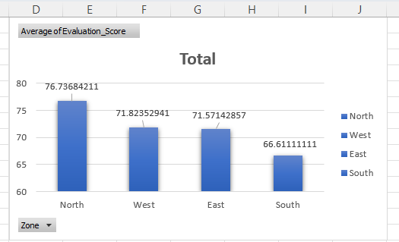
Visualizations: Bar Chart – Average Evaluation Scores by Zone The chart compares overall performance levels across different zones. Zones with higher averages demonstrate better service consistency and operational effectiveness. Lower-scoring regions may require additional supervision, training, or resource support. The variation indicates opportunities for cross-learning from top-performing zones.

Slide 6
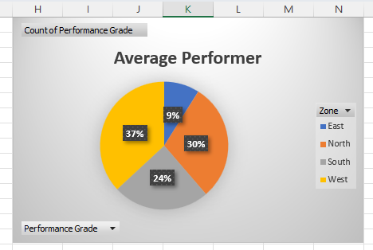
Pie Chart – Percentage of High Performers by Zone The distribution shows how top talent is spread geographically. Zones contributing a larger share of high performers can act as internal benchmarks. Regions with smaller contributions highlight potential improvement areas. The analysis helps management focus recognition and replication of best practices.

Slide 7
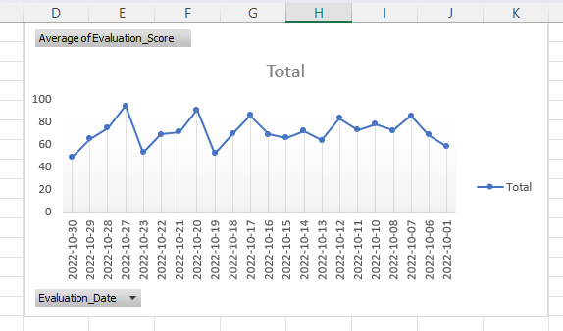
Line Chart – Performance Trend Over Time The line graph highlights how evaluation scores change across time periods. Upward trends indicate successful improvements in service quality. Declines may signal operational challenges or workforce issues. Continuous tracking supports proactive performance management.

Slide 8
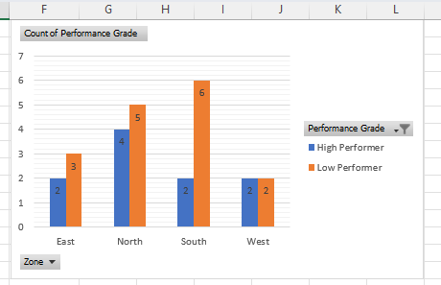
Stacked Bar – High vs Low Performers Comparison This chart clearly presents the balance between strong and weak performers. Zones with higher low-performer counts may face service quality risks. A better distribution toward high performers indicates workforce effectiveness. The visualization helps prioritize coaching and mentoring efforts.

Slide 9
Key Insights . Majority of advisors fall in Average category. . Certain zones consistently outperform others. . Some criteria show weaker ratings across regions. . Trend analysis shows periods of improvement / decline. . Gap between high and low performers exists in select zones.

Slide 10
Recommendations Based on analysis: . Provide focused training where low scores dominate. . Replicate best practices from top zones. . Introduce mentoring for low performers. . Monitor weak criteria with stricter supervision. . Use periodic evaluation to maintain consistency.

Slide 11
Conclusion The study successfully transformed raw evaluation data into measurable insights. The findings help management: ✔ identify strengths ✔ detect weaknesses ✔ plan training ✔ improve customer experience Data-driven monitoring can significantly enhance service standards.

